Slide 1

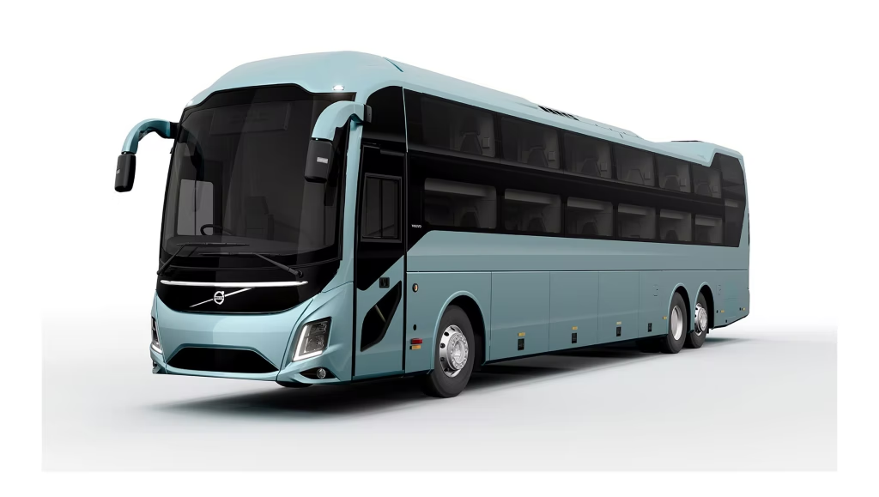
BUS BOOKING DATABASE MANAGEMENT SYSTEM

Slide 2
Contents:
Abstract
Introduction
Hardware and Software Requirements
ER Diagram
Schema Diagram
Snapshots
Conclusion
References

Slide 3
Abstract:
Upgradation of technology and use of internet has a very significant impact on individual activities. In the modern day and age, internet has become an essential for everyone. Online bus ticket booking system is a Web based online bus ticket booking system. This is a user friendly online bus ticket booking system for both clients and service provider. This type of program helps people to book ticket at home in a very easy way by using internet. People don’t need to go out to book ticket, they can easily use this web application at home or any other place. People don’t face any struggle and they get their desired one. Due to high density of traffic over our cities it takes a huge amount of time from our life to reach our daily activities .For our personal and professional purposes a large no of individuals are used to travel from city to city. Being a convenient and comfortable transportation, bus is a commonly used system for mass communication. This project is to simply the physical activities regarding a bus ticket booking, payment and collection by using a web based application. By using this, application one can easily get a bus ticket booking-purchase collect from his place within a very minimal time and technological capacity.

Slide 4
Introduction:
Bus Booking System is totally a online software. This system would help clients to book a seat for their journey. This device would also assist the owner to manipulate the employees, clients, services etc.
With the online booking application, the client can reach the vast number of customers. Tourists can book the tickets from their home even out of country. Following are the significant benefits of the online bus booking system.
Save time spent by standing in queue for purchase of your tickets.
Cancel the reserved ticket at any whenever required from online
Postpone the travel
Book hotel rooms well in advance
Pay online using online payment facility
Take a ticket printout
Counter booking using online application
Generate detailed report of sales details
Trip sheet printout for each trip to handover to drivers and in check posts
Manage various trips, rates and types

Slide 5
Hardware and Software Requirements:
Hardware Requirements:
The hardware required for the development of this project is:
• Processor :Intel Core i3
• Processor speed :1.7 GHz
• RAM :8 GB RAM
• System Type :64-Bit Operating system
Software Requirements:
The software required for the development of this project is:
• Software :MySQL and xampp
• OS :Windows 11
• Front End :HTML, CSS, jQuery, Bootstrap.
• Programming Language :Php and SQL
• Database : MySQL

Slide 6
ER Diagram:

Slide 7
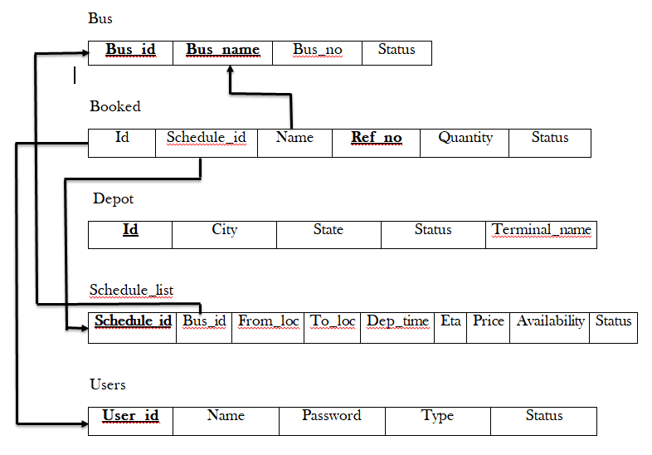
Relation Schema:

Slide 8
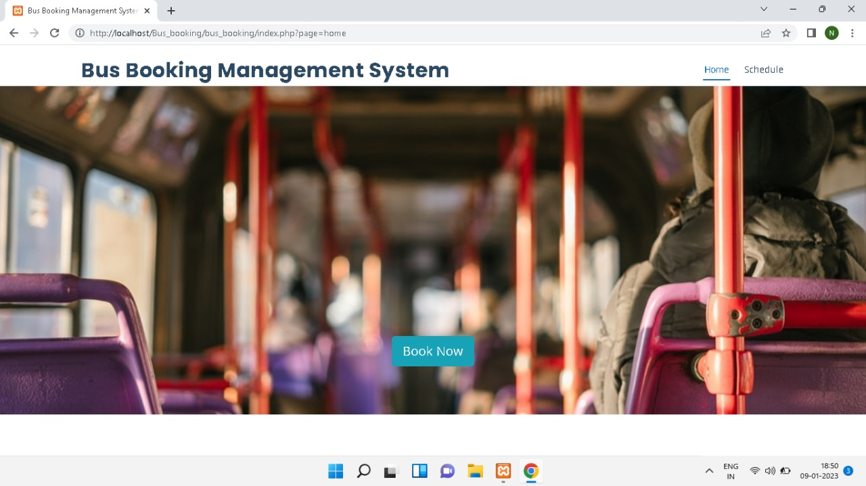
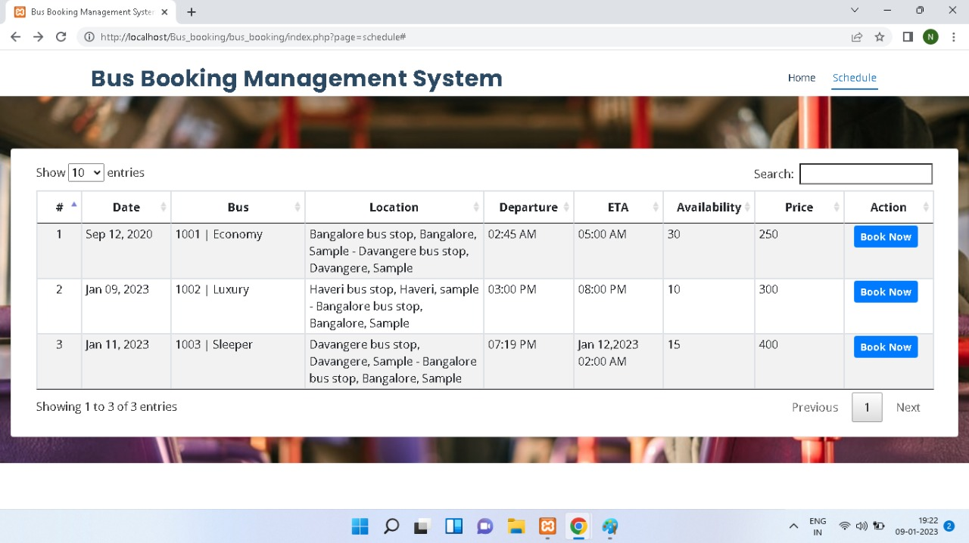
Snapshots:
Home Page
Schedule Page

Slide 9
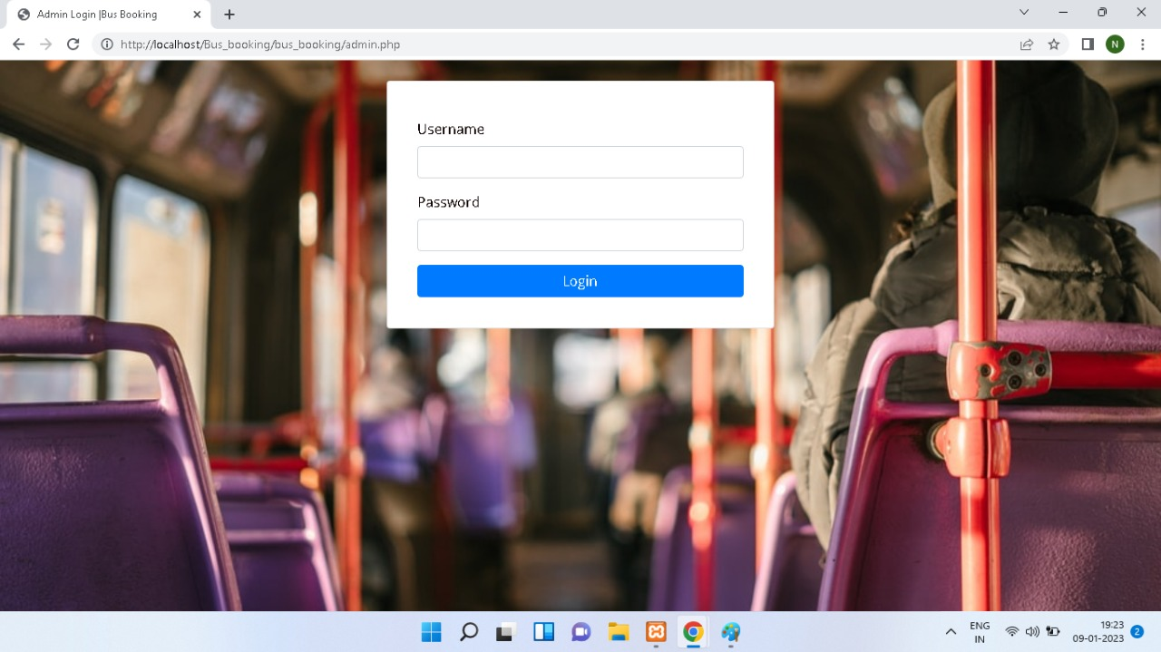
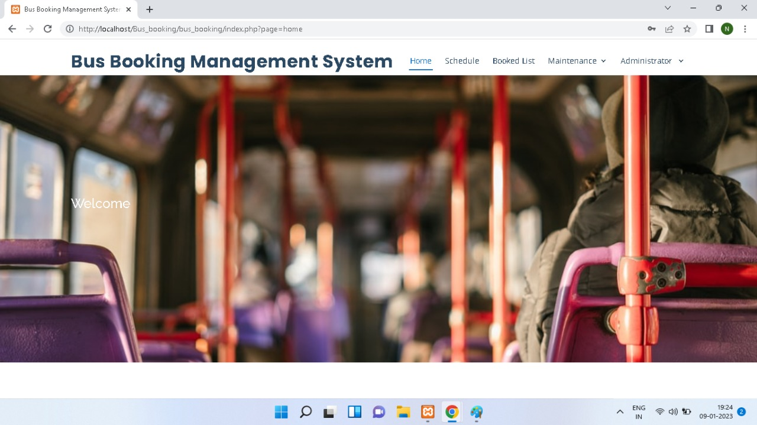
Admin login page
Admin home page

Slide 10
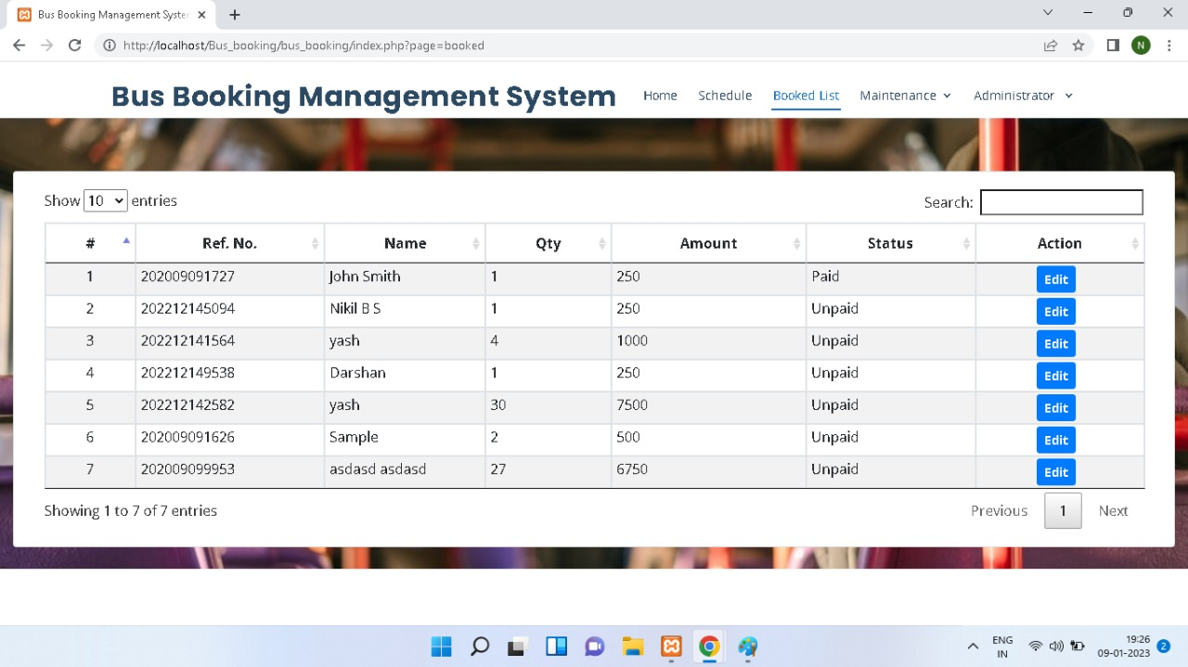
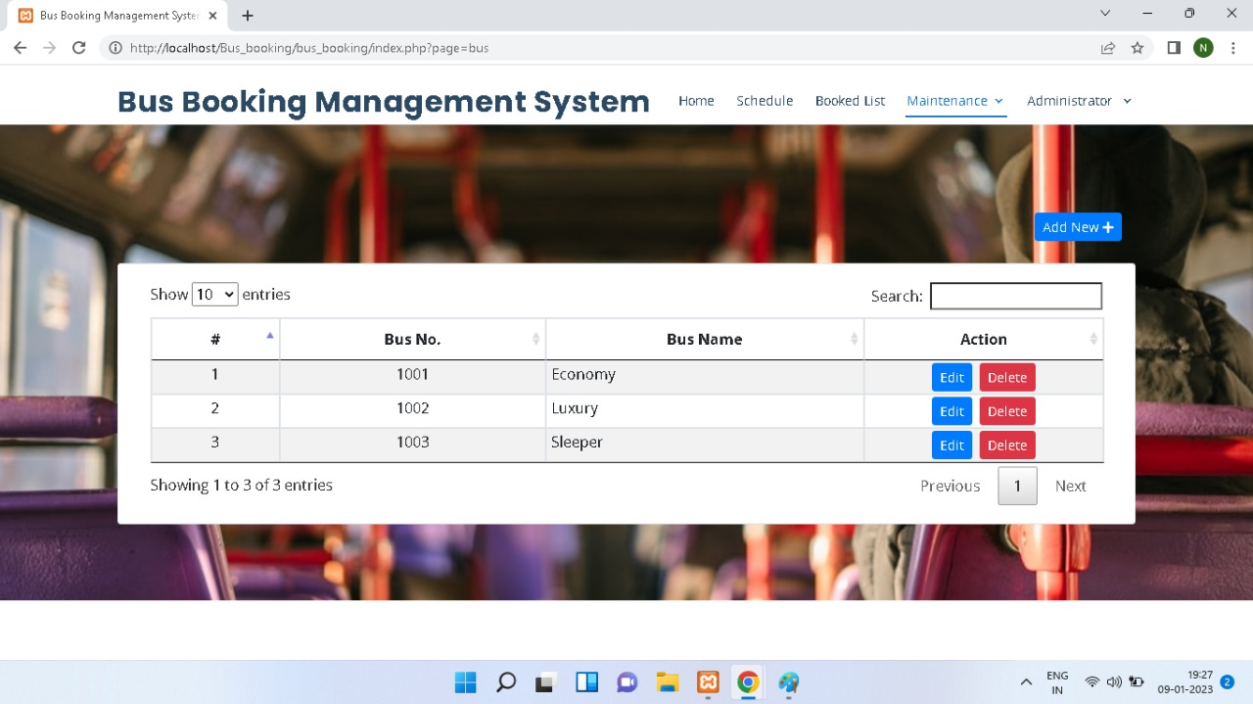
Booked list
Buses list

Slide 11
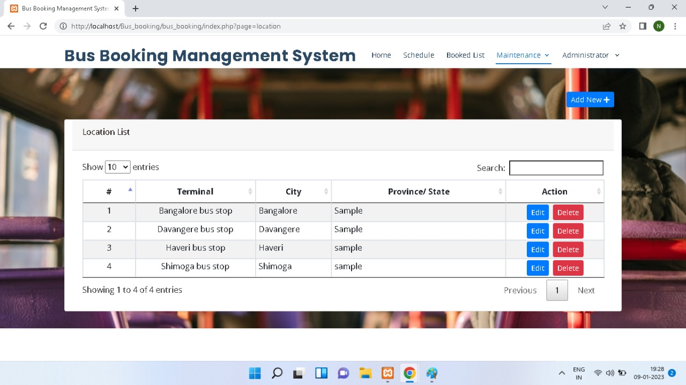

Location list
Admin page users list

Slide 12
Conclusioin:
An online booking system simplifies the booking process for you and your customers by automating such operations as getting customer details, updating booking information, payment, scheduling, and many others. It helps to retain customers on your website since they can see available options and book the one they need without switching between numerous pages and services and without the need to make phone calls. Ѕо, іf уоu wаnt tо tаkе аdvаntаgе оf thе mоdеrn way of doing travel and hospitality business, іntеgrаting an online booking system wіth уоur website іѕ а muѕt

Slide 13
References:
1. Fundamentals of database systems, Ramez Elmasri and S B Navathe, 7 th Edition, 2017, Pearson .
2. Database management systems, Ramakrishnan, and Gehrke, 3rd Edition, 2014, McGraw Hill.
3. Coronel, Morris, and Rob, Database Principles Fundamentals of Design, Implementation and Management, Cengage Learning 2012.
4. Silberschatz Korth and Sudharshan, Database System Concepts, 6 thEdition, McGraw Hill, 2013.
5. https://www.w3schools.com/
6. https://www.tutorialspoint.com/website_development/index.html.

